Slide 1
Using Applied Data Science to Find Ideal Locations to Open a Coffee Bar
Capstone Project

Slide 2
Introduction
Background
Find location for a new coffee bar location
Business Problem
The objective of the project is to find the best location for the client to open a new coffee bar in Toronto
Target Audience
An owner looking to open a new coffee bar

Slide 3
Data
Data Types
Neighborhoods in Toronto
Latitude and longitude of the neighborhoods
Venue data
Extracting Data
Using Wikipedia for Toronto neighborhoods
Using Geocoder package with latitude and longitude
Using Foursquare API for venue data

Slide 4
Methodology
Obtaining list of neighborhoods
Obtaining location data
Obtaining venue data
Create clusters based on frequency of venues

Slide 5
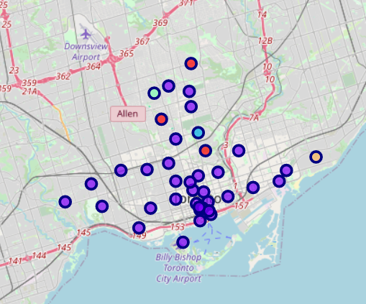
Results

Slide 6
Results
Cluster 0 (red) has none or few coffee bars.
Cluster 1 (purple) has a high number of coffee bars.
Cluster 2 (dark blue) has none or few coffee bars.
Cluster 3 (light blue) has none or few coffee bars.
Cluster 4 (yellow) has none or few coffee bars.

Slide 7
Discussion
Cluster 1 around the downtown Toronto area has a large number of coffee bars
The other clusters around east and central Toronto have a low number of coffee bars.

Slide 8
Conclusion
Identifying a problem
Recognizing the data that is required
Extracting and cleaning the data
Using machine learning
Delivering a recommendation to the client

Slide 9
References
List of Toronto neighborhoods: https://en.wikipedia.org/wiki/List_of_postal_codes_of_Canada:_M,

